Slide 1
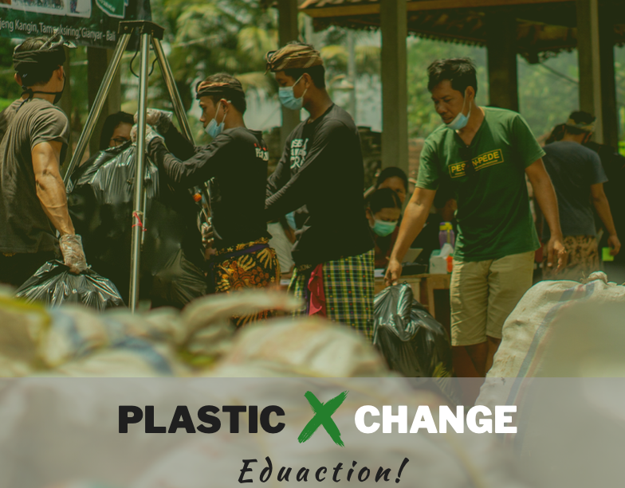
Kernel of Validation
A community-based data validation process, using Plastic Exchange as a case study

Slide 2
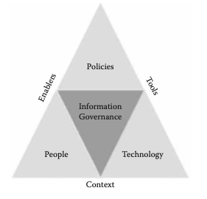
Context: The Value of Trust-worthy Data
Social stability/coherence comes from effective information governance:
Institutionalized Regulations
Consumers and Data Observers
Infrastructure Operators
p. 225, Fig. 9.1 of Data Governance, by Neera Bhansali

Slide 3






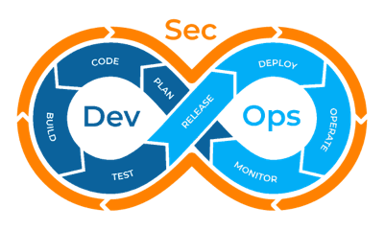
Data Collection Mechanisms and Sources of Truth
Data becomes trust-worthy, when observed data content agrees multiple independent data sources
Institutionally Certified Data Quality Standards
Technically Sound Data Processing Workflow
Community Accepted Data Exchange Protocol

Slide 4
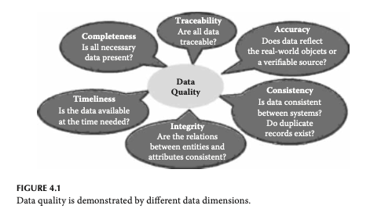
Qualities of Data Assets
Data assets become useful only if:
Timeliness: Data availability on-demand
Accountability: Content and errors are traceable to data sources and digital identities of responsible parties.
Data Integrity: Completeness, Accuracy, Consistency, and other objectively verifiable integrity concerns, such as data normalization.
On p. 66 of Data Governance, by Neera Bhansali

Slide 5
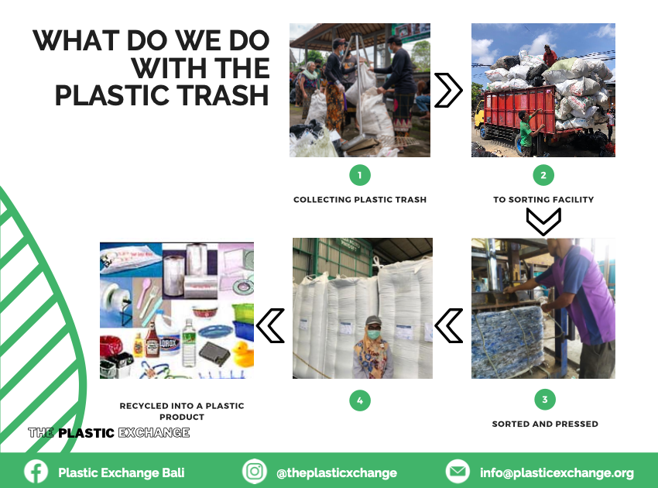
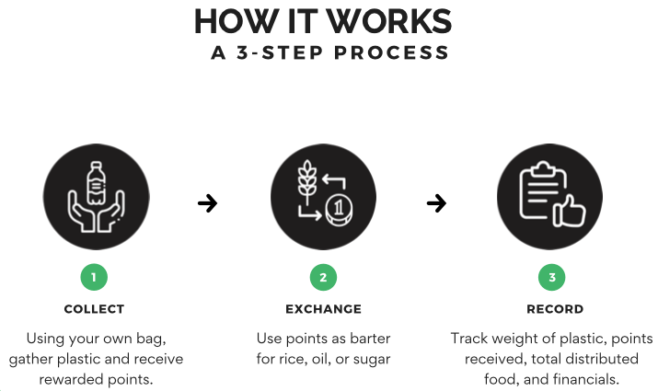
Plastic Exchange Bali mobilized local communities
Since June 2020, more than 250 tons of plastic and paper carton has been collected and centrally recycled.

Slide 6
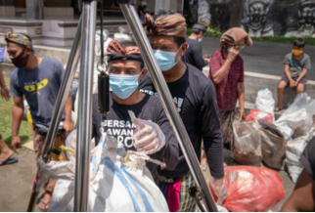
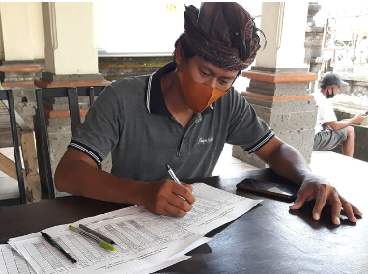
Current Data Collection Practice
Many community services use manual data collection, interpretation and paper-based data storage
For short term and small scale operations, manually recorded data has proven to work.

Slide 7
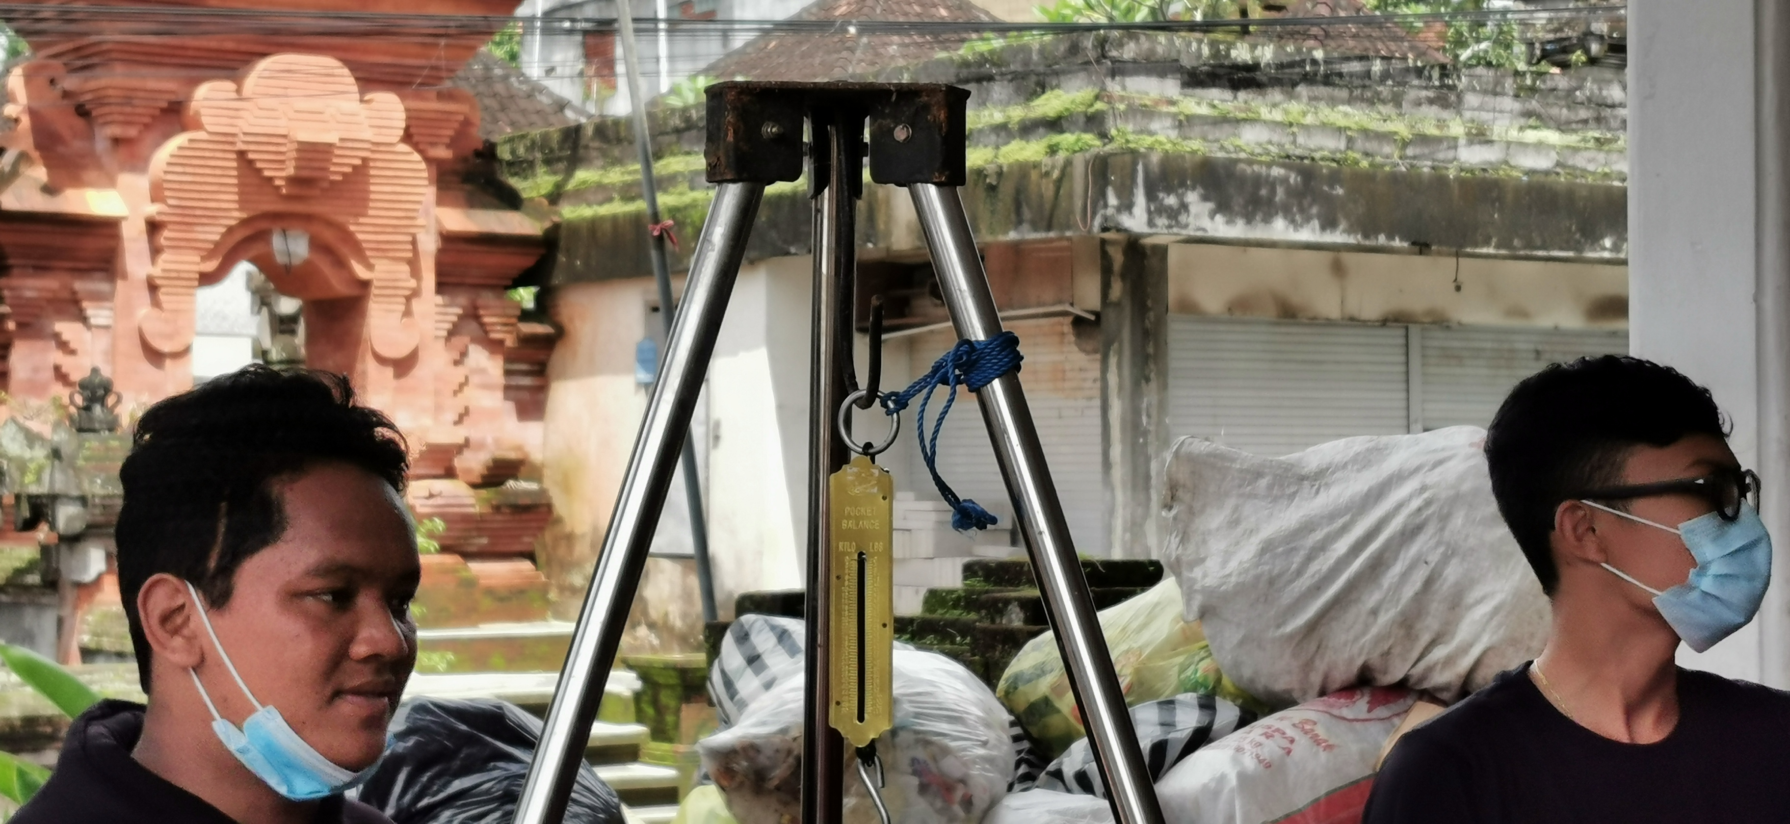
Networked Data Collection Process
Many community services use manual data collection, interpretation and paper-based data storage
People Gather Plastic
Identify Plastic Gatherer’s Identity
Take a picture while Weighting
Plastic
Submit the picture to Web Server
Presenting ID to collect Rice
For short term and small scale operations, manually recorded data has proven to work.

Slide 8
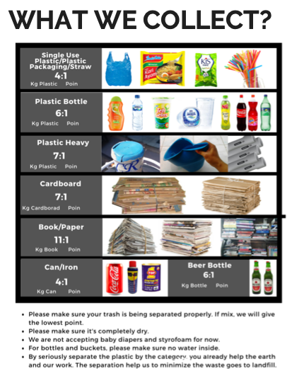
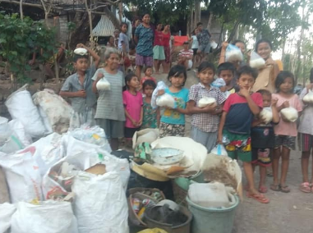
Where are the improvement opportunities?
A number of issues will challenge the scalability and stability of the community program:
When more types of “waste” materials are to be collected, the recording process will be more complex, and therefore prone to errors.
When many more people are involved, the total amount of rice or other goods purchased will create a larger inventory, creating a potential incentive of corruption.
Currently, the total amount of rice dispensed and money collected is small enough for manual accounting practice.
Manual accounting and inventory management prevent more efficient fund raising and more complex exchange practices.

